Slide 2
Review Interpretative Principles
Language and Literature
Apocalyptic literature in dramatic, symbolic language, frequently drawing from the Old Testament.
Prophetic message designed to elicit a response—specifically repentance.
An epistle, or letter, to a real audience experience real problems.
Notes:
To place pictures, graphics, etc.

Slide 3
Review Interpretative Principles
Structure and Sequence
Series of 7’s (churches, letters, seals, trumpets, bowls)
Parallel series recapping the same time from the 1st (birth) to 2nd coming of Jesus.
Notes:
To place pictures, graphics, etc.

Slide 4
Review Interpretative Principles
Time and Audience
Things that were past, present, and future to the original recipients.
Visions given in language and images that would have been meaningful to the original recipients.
Notes:
To place pictures, graphics, etc.

Slide 5
Looking at Revelation 8-11 INFORMATIONALLY.
The goal is to understand “What the Bible says”.
Dr. Jonathan Pennington
“Come and See”
Notes:
Size: 44 pt
Bold or Regular
Utilize accent colors

Slide 6
Chapter 8
8:1-5 Silence in Heaven & the Golden Censer
How Long?
Notes:
Main Point: Bold (44 pt)
Scripture: Regular (36 pt)
Scripture Reference Regular (36 pt)

Slide 7
Chapter 8
8:6-13 1st thru 4th Trumpets
Hail & Fire & blood burn up 1/3 of the earth
A burning mountain is thrown into the sea and 1/3 becomes blood
A star falls into the fresh waters and turns them bitter
The celestial bodies are struck and go dim
Notes:
Main Point: Bold (44 pt)
Scripture: Regular (36 pt)
Scripture Reference Regular (36 pt)

Slide 8
Adapted from James M. Hamilton Jr., God’s Glory in Salvation through Judgement (Crossway, 2010), p. 547.

Slide 9
Adapted from James M. Hamilton Jr., God’s Glory in Salvation through Judgement (Crossway, 2010), p. 547.

Slide 10
Chapter 9
9:1-12 5th Trumpet
A star falls to earth, he opens the bottomless pit and locusts come upon the earth.
Notes:
Main Point: Bold (44 pt)
Scripture: Regular (36 pt)
Scripture Reference Regular (36 pt)

Slide 11
Luke 10:18
And he said to them, “I saw Satan fall like lightning from heaven.
Rev 12:7
Now war arose in heaven, Michael and his angels fighting against the dragon. And the dragon and his angels fought back,
Notes:
Main Point: Bold (44 pt)
Scripture: Regular (36 pt)
Scripture Reference Regular (36 pt)

Slide 12
Chapter 9
9:13-21 6th Trumpet
Resembles fifth, but this time with horses rather than locusts.
Notes:
Main Point: Bold (44 pt)
Scripture: Regular (36 pt)
Scripture Reference Regular (36 pt)

Slide 13
Look at v 20-21
The rest of mankind, who were not killed by these plagues, did not repent of the works of their hands nor give up worshiping demons and idols of gold and silver and bronze and stone and wood, which cannot see or hear or walk, nor did they repent of their murders or their sorceries or their sexual immorality or their thefts.
Notes:
Main Point: Bold (44 pt)
Scripture: Regular (36 pt)
Scripture Reference Regular (36 pt)

Slide 14
Church in Pergamum in 2:14
But I have a few things against you: you have some there who hold the teaching of Balaam, who taught Balak to put a stumbling block before the sons of Israel, so that they might eat food sacrificed to idols and practice sexual immorality.
and Thyatira in 2:20-21
But I have this against you, that you tolerate that woman Jezebel, who calls herself a prophetess and is teaching and seducing my servants to practice sexual immorality and to eat food sacrificed to idols. I gave her time to repent, but she refuses to repent of her sexual immorality.
Notes:
Main Point: Bold (44 pt)
Scripture: Regular (36 pt)
Scripture Reference Regular (36 pt)

Slide 15
Chapter 10
10:1-11 The Angel and the Little Scroll
Another interlude
Gives us a picture of what is happening to God’s people during the judgements
Seals interlude: God’s people on Mt. Zion and worshipping in heaven, emphasizing their security.
Trumpets interlude: emphasizing their witness.
Notes:
Main Point: Bold (44 pt)
Scripture: Regular (36 pt)
Scripture Reference Regular (36 pt)

Slide 16
Chapter 11
11:1-14 The Two Witnesses
The Church is referred to as the temple of God
1 Corinthians 3:16
Do you not know that you are God's temple and that God's Spirit dwells in you?
Notes:
Main Point: Bold (44 pt)
Scripture: Regular (36 pt)
Scripture Reference Regular (36 pt)

Slide 17
2 Corinthians 6:16
What agreement has the temple of God with idols? For we are the temple of the living God; as God said,
“I will make my dwelling among them and walk among them, and I will be their God, and they shall be my people.
Notes:
Main Point: Bold (44 pt)
Scripture: Regular (36 pt)
Scripture Reference Regular (36 pt)

Slide 18
Ephesians 2:19-22
So then you are no longer strangers and aliens, but you are fellow citizens with the saints and members of the household of God, built on the foundation of the apostles and prophets, Christ Jesus himself being the cornerstone, in whom the whole structure, being joined together, grows into a holy temple in the Lord. In him you also are being built together into a dwelling place for God by the Spirit.
Notes:
Main Point: Bold (44 pt)
Scripture: Regular (36 pt)
Scripture Reference Regular (36 pt)

Slide 19
Rev 21:9-10
Then came one of the seven angels who had the seven bowls full of the seven last plagues and spoke to me, saying, “Come, I will show you the Bride, the wife of the Lamb.” And he carried me away in the Spirit to a great, high mountain, and showed me the holy city Jerusalem coming down out of heaven from God,
Notes:
Main Point: Bold (44 pt)
Scripture: Regular (36 pt)
Scripture Reference Regular (36 pt)

Slide 20
Who are the two witnesses? 11:4
We already know that the lampstands are the churches, two that were faithful (Smyrna and Philadelphia)
The reference to the two olive trees goes back to Zechariah 4:1-14
The witnesses have the powers of Elijah and Moses
Notice verse 8:
and their dead bodies will lie in the street of the great city that symbolically is called Sodom and Egypt, where their Lord was crucified.
Notes:
Main Point: Bold (44 pt)
Scripture: Regular (36 pt)
Scripture Reference Regular (36 pt)

Slide 21
Notice all these references to 42 months, 1260 days, 3 1/2 years. These all come from Daniel 9:24-27
Notes:
Main Point: Bold (44 pt)
Scripture: Regular (36 pt)
Scripture Reference Regular (36 pt)

Slide 22
Sam Storms, Kingdom Come (Mentor, 2013), p. 483.
“In other words…”a time, times, and half a time,” or “42 months,” or “1260 days,” or “3 ½ years,” are all theological, not chronological, designations. They have in view the kind or quality of time, not its duration. The important thing is not how long events happen, but what kind of events happen.”
Notes:
Main Point: Bold (44 pt)
Scripture: Regular (36 pt)
Scripture Reference Regular (36 pt)

Slide 23
Chapter 11
11:15-19 7th Trumpet
Verse 15
Then the seventh angel blew his trumpet, and there were loud voices in heaven, saying, “The kingdom of the world has become the kingdom of our Lord and of his Christ, and he shall reign forever and ever.”
Notes:
Main Point: Bold (44 pt)
Scripture: Regular (36 pt)
Scripture Reference Regular (36 pt)

Slide 24
Chapter 11
11:15-19 7th Trumpet
The elders now testify about God.
V17 There is no “is to come”
saying,
“We give thanks to you, Lord God Almighty, who is and who was, for you have taken your great power and begun to reign.
Notes:
Main Point: Bold (44 pt)
Scripture: Regular (36 pt)
Scripture Reference Regular (36 pt)

Slide 25
V18 The dead are judged and rewards are given (compare with 20:11-12)
18 The nations raged, but your wrath came, and the time for the dead to be judged, and for rewarding your servants, the prophets and saints, and those who fear your name, both small and great, and for destroying the destroyers of the earth. | 11 Then I saw a great white throne and him who was seated on it. From his presence earth and sky fled away, and no place was found for them. 12 And I saw the dead, great and small, standing before the throne, and books were opened. Then another book was opened, which is the book of life. And the dead were judged by what was written in the books, according to what they had done.
Notes:
Main Point: Bold (44 pt)
Scripture: Regular (36 pt)
Scripture Reference Regular (36 pt)

Slide 26
Compare 11:19 with 8:5
19 Then God's temple in heaven was opened, and the ark of his covenant was seen within his temple. There were flashes of lightning, rumblings, peals of thunder, an earthquake, and heavy hail. | 5 Then the angel took the censer and filled it with fire from the altar and threw it on the earth, and there were peals of thunder, rumblings, flashes of lightning, and an earthquake.
Notes:
Main Point: Bold (44 pt)
Scripture: Regular (36 pt)
Scripture Reference Regular (36 pt)

Slide 27
Summary
The themes of witness, testimony, and repentance (2 Timothy 3:12-13)
Indeed, all who desire to live a godly life in Christ Jesus will be persecuted, while evil people and impostors will go on from bad to worse, deceiving and being deceived.
See Revelation through the eyes of the original audience: external persecution and internal temptation of cultural assimilation by false teachers
Notes:
Main Point: Bold (44 pt)
Scripture: Regular (36 pt)
Scripture Reference Regular (36 pt)

Slide 28
Summary
Judgements, their purpose is to bring people to repentance: 2 Peter 3:9
The Lord is not slow to fulfill his promise as some count slowness, but is patient toward you, not wishing that any should perish, but that all should reach repentance.
The church has a mission to testify for the Lord, which will be a very difficult one.
God’s people are not delivered from death or martyrdom, but through it to a glorious resurrection.
Notes:
Main Point: Bold (44 pt)
Scripture: Regular (36 pt)
Scripture Reference Regular (36 pt)

Slide 29
Week 1: Setting the Stage
Week 2: Reading Revelation Informationally Ch 1-7
Week 3: Reading Revelation Informationally Ch 8-11
Week 4: Reading Revelation Informationally Ch 12-16
Week 5: Reading Revelation Informationally Ch 17-22
Week 6: Reading Revelation Theologically & Transformationally
Notes:
Heading: Bold OR Regular (44 pt)
Text: Regular (36 pt)

Slide 30
Assignment for Week 4
Read the entire book of Revelation
Look for parallels between the sections
Notes:
Heading: Bold OR Regular (44 pt)
Text: Regular (36 pt)

Slide 31
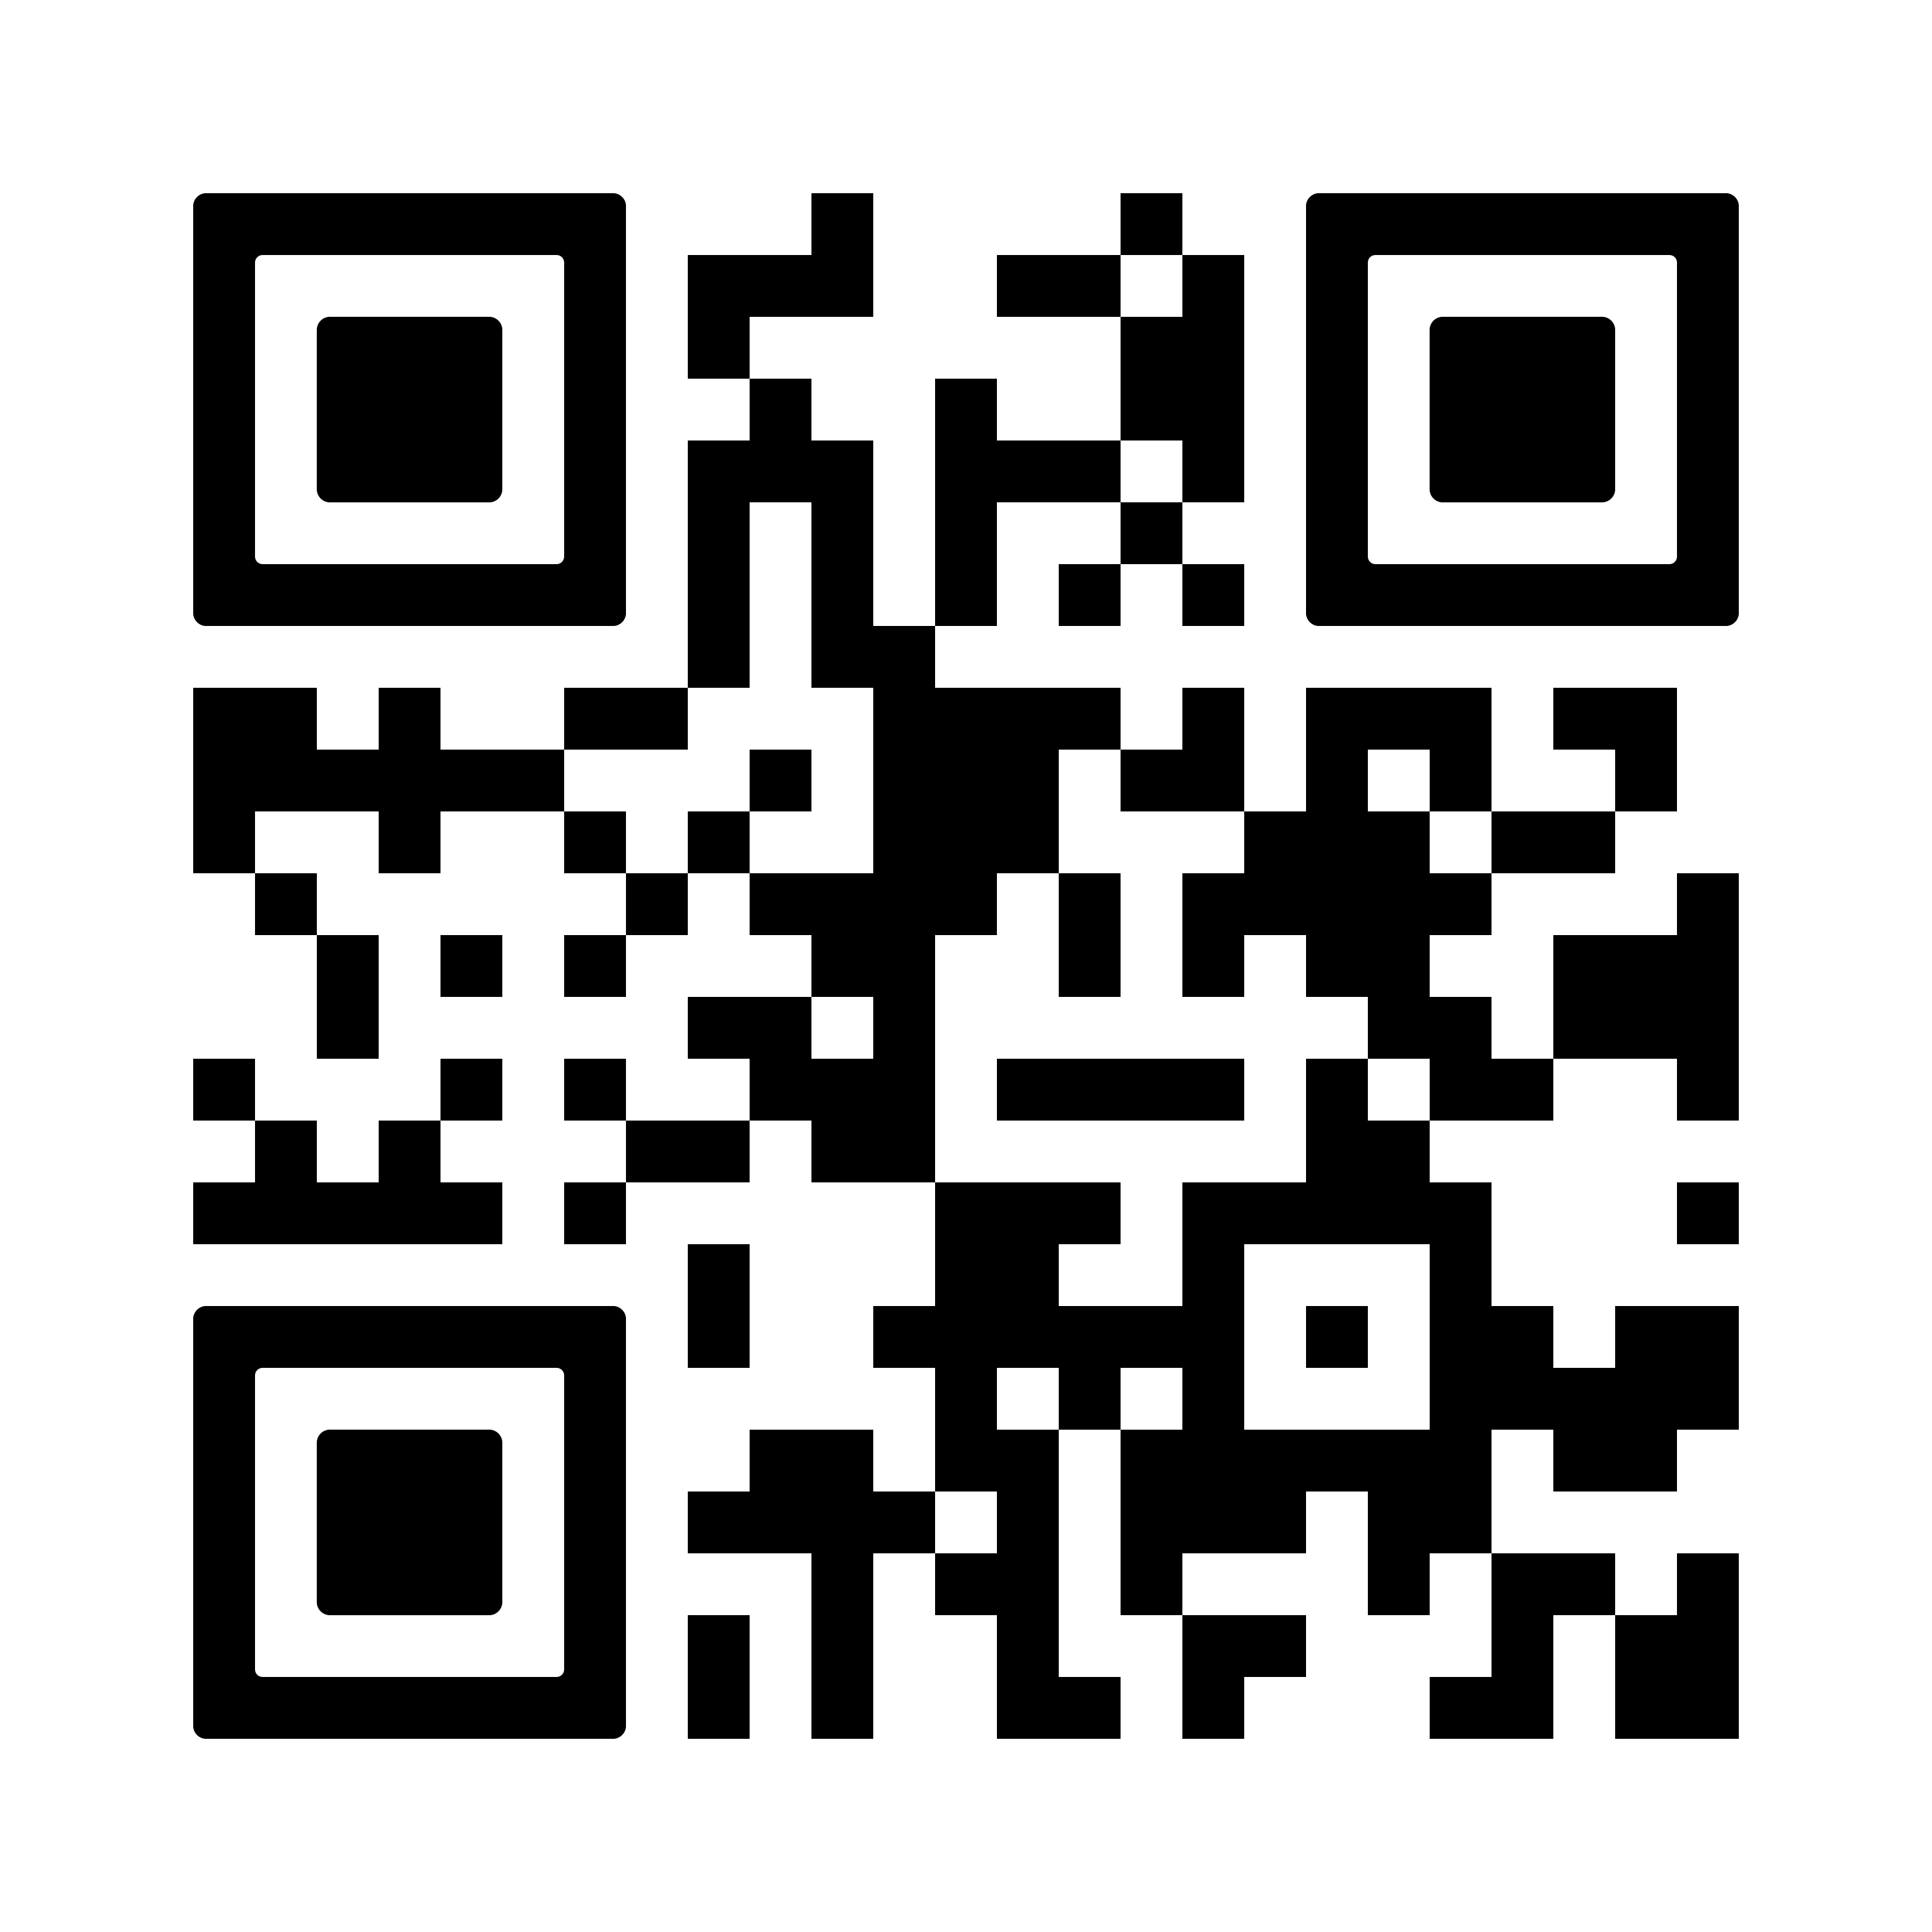
Got questions?

