Slide 2
Quick Review of Interpretive Principles
Language and Literature
Structure and Sequence
Time and Audience
Notes:
Heading: Bold OR Regular (44 pt)
Text: Regular (36 pt)

Slide 4
Reading Revelation Theologically
Christ is among the churches
The judgements (seal, trumpets, bowls) are meant to induce repentance, not punishment
Good and evil will co-exist until the end
The dragon is bound, but still influential
Notes:
Heading: Bold OR Regular (44 pt)
Text: Regular (36 pt)

Slide 5
Reading Revelation Theologically
5. The dragon is bound, but Christ reigns
6. The beasts are ever-present through changing incarnations as it rises and falls over the years
7. The mark of the beast is ever-present and ever-changing by culture and time
Notes:
Heading: Bold OR Regular (44 pt)
Text: Regular (36 pt)

Slide 6
Reading Revelation Theologically
8. The saints are called to witness to the world
9. The saints will suffer, but Christ wins the ultimate victory
10. The end of the story is a complete reversal and restoration of all the damage and havoc caused by the dragon
Notes:
Heading: Bold OR Regular (44 pt)
Text: Regular (36 pt)

Slide 7
Reading Revelation Transformationally
We still face persecution and cultural seduction
Our call is the same: to witness
We are called to shine light in specific contexts
Notes:
Heading: Bold OR Regular (44 pt)
Text: Regular (36 pt)

Slide 8
We are living in Babylon! How do we do this??
Critical thinking and discernment
Closely examine who or what we give our allegiance
View everything through spiritual eyes
Prepare for opposition from the beast
Don’t neglect to worship the Lamb!
Notes:
Heading: Bold OR Regular (44 pt)
Text: Regular (36 pt)

Slide 9
How does Revelation fit with other Biblical Passages?
Ezekiel 39 & 39 (Gog and Magog)
Daniel 9:24-27 (The Seventy Weeks)
Matthew 24 (Olivette Discourse)
Matthew 13 (Parable of the Reaper)
1 Corinthians 15 (The Resurrection)
Notes:
Heading: Bold OR Regular (44 pt)
Text: Regular (36 pt)

Slide 10
How does Revelation fit with other Biblical Passages?
6. 1 Thessalonians 4 & 5 (Return of Jesus)
7. 2 Thessalonians 2 (Man of Lawlessness)
8. 1 Peter 3:1-13 (The Day of the Lord)
9. 1 John 4:1-6 (The Antichrist)
Notes:
Heading: Bold OR Regular (44 pt)
Text: Regular (36 pt)

Slide 11
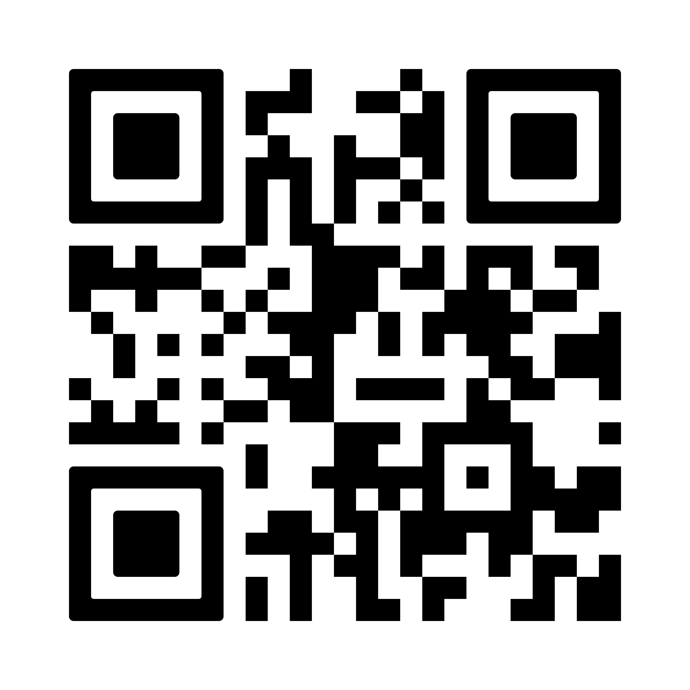
Got questions?

